Slide 1

Notes and Password Manager
Mentor Name – Ms. Tanusha Mittal
Name – Adarsh patel
University roll No. - 2019527

Slide 2

Problem Statement
Notes and Password Manager app

Slide 3

INTRODUCTION
In the Following sections, a brief introduction for the work has been included.
It’s a GUI-based project used with the swing library to organize all the elements that work under the Notes and Password Manager.
Notes and Password Manager is an application that helps users securely store and organize their notes and passwords. It offers features such as Store Password, Search Password, Add Note and Display Note. The app allows users to store all of their confidential information in one place. The app also offers a variety of customization options and the ability to share information with others. In addition, Notes and Password Manager also provides users with an easy-to-use and intuitive interface, making it easy to manage their information.
Features
Store and Retrieve passwords
Add a note and view the note added

Slide 4

Methodology
1. Design: This is the initial step of the development process. It involves understanding the requirements of the project and designing the architecture of the application. This includes deciding on the technologies to be used, the programming language to be used, the database structure, and the overall design of the application.
2. Coding: After the design phase is complete, the coding begins. This involves writing the code for the application in the chosen programming language. This includes writing the code for the user interface, the database structure, the business logic, and integrating the application with any external services.
3. Testing: Once the coding phase is complete, the application needs to be tested to ensure that it works as expected. This involves testing the application for bugs, performance, and usability.
4. Maintenance: After the application is deployed, it needs to be maintained. This involves fixing any bugs that are discovered, adding new features, and updating the application as required.

Slide 5

Code Explanation
So I have made this code in such a way that first I have made the separate class which is class SplashScreen were the Loading screen is designed to make the App more interesting and creative.
In SplashScren we have called 4 Function( ) which is-:
1. create( )
In this Function we have created the frame of the Loading screen for the User.
2. addText( )
In this Function we have Declared the font type, its size, color and Text.
3. addProgramBar( )
In this Function we have made the Bar for the Loading Screen to make it user friendly.
4. runningPBar( )
In the Function inside the bar which shows the loading percentage from 0 to 100% were 100 is the termination point.

Slide 6

Notes And Password Function Explanation
Notes
The code creates a Jframe and a JButton, both called "Get Note". The JButton is set to a specific size and location and then added to the JFrame. An action listener is then added to the JButton, which checks if the button has been pressed. If it has, it will then check if the last note added is empty or not. If it is empty, a message dialog will be shown saying that no note was found. If the note is not empty, it will be displayed in a text area and a message dialog will be shown. Finally, a message dialog will be shown if the user tries to retrieve a note before adding one.
Password
This code is creating a Password Manager GUI. The PasswordManager() function creates the components of the GUI such as frames and buttons. The JFrame is created and its size and close operation is set. The buttons for the GUI are also created and their size and visibility is set. The GUI ButtonsSetting( ) function is used to set the properties of the buttons such as font, background and foreground colors. The PassStoreBtn button is used to store the entered account name and password in the hashtable. The StoringGUI( ) function is used to create the components of the store frame. The AccAddBtn is used to actually add the account name and password to the hashtable. The PassSearchBtn is used to search the password of the entered account name. The searchPassArea is used to display the password of the account.

Slide 7

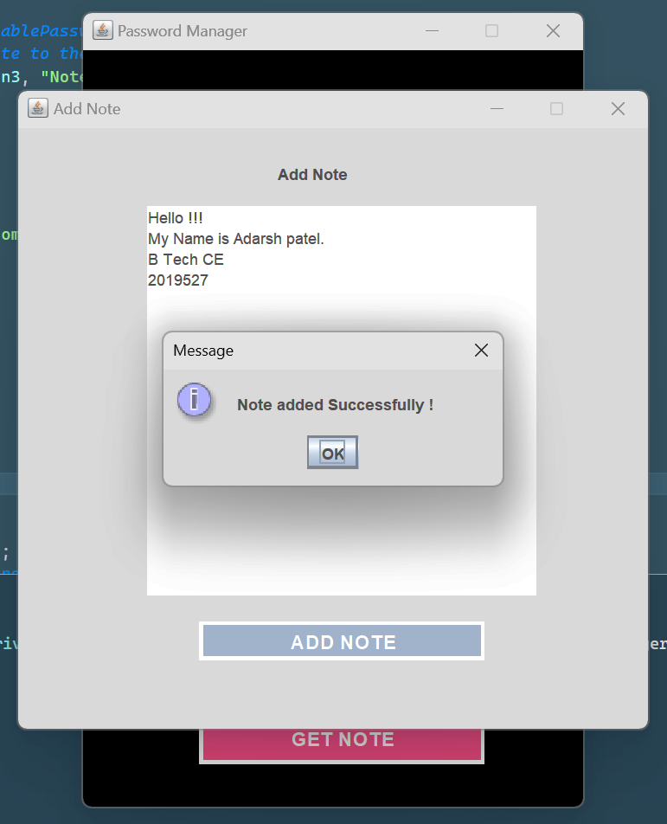
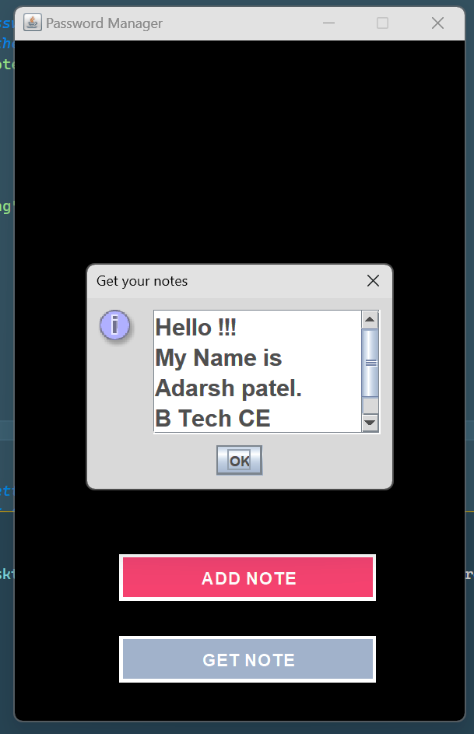
Result of Notes
Entering the Notes
Displaying the Notes

Slide 8
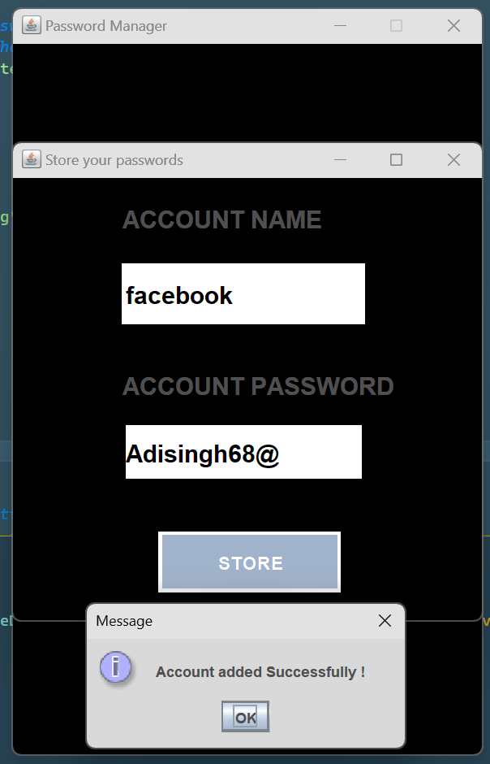
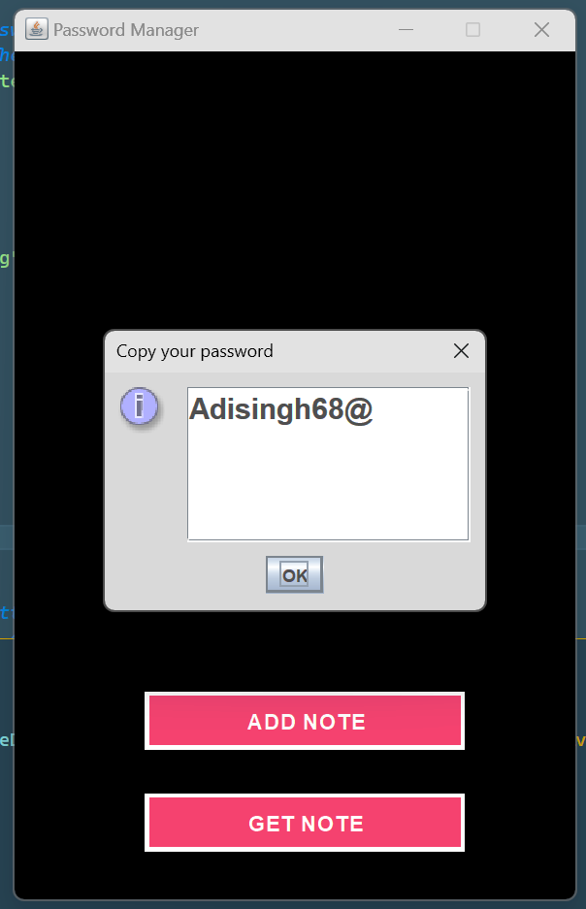
Result of Password
Entering the Username and Password
Displaying the Username and Password

Slide 9

Discussion
Java is an excellent language for developing applications, including Notes and Password managers. It offers a number of advantages, such as a large library of components and packages, the ability to create custom user interfaces, and excellent security. It should be easy to use, secure, and should be able to store both the passwords and the associated usernames. It should also provide users with the ability to access their passwords from multiple devices. Java provides a high level of security by encrypting data and using digital signatures.

Slide 10

Conclusion & Future
Conclusion
Future
At the conclusion of making notes and Password Manager app, the developer should ensure that the app has a good user interface, is secure and efficient and has a backup system. The user should be able to easily store, manage, and track all their passwords, notes, and other sensitive information. The app should also have warning notifications when the user is about to enter a wrong credential. Additionally, the app should provide a secure storage system which is difficult to breach. Furthermore, the app should also have an automatic backup system which saves the data in the cloud. Finally, the developer should also provide a help section and FAQs to help the user with any issues they may have.
Biometrics: Biometrics is a technology that uses physical characteristics, such as fingerprints and retinal scans, to identify users. This technology is useful for securing notes and passwords as it provides a more secure alternative to traditional passwords.
Artificial Intelligence: AI-powered notes and password managers can be used to automatically store, encrypt, and secure notes and passwords. These systems can also use predictive analytics to suggest the most secure passwords and detect security threats in real time.
Cloud Storage: Cloud-based notes and password management systems can provide a secure way to store and access data from any device or location. These systems can also be used to securely share notes and passwords with other users.
Blockchain: Blockchain-based notes and password managers can be used to store and share data in a secure and immutable way. This technology can also be used to securely store and verify digital signatures.
Natural Language Processing: Natural language processing can be used to automatically generate secure passwords based on a user’s natural language inputs. This technology can also be used to detect security threats in real time and suggest the most secure passwords.

Slide 11
Thank You

